Slide 1
Natural Language Processing
Syntactic Parsing

Slide 2
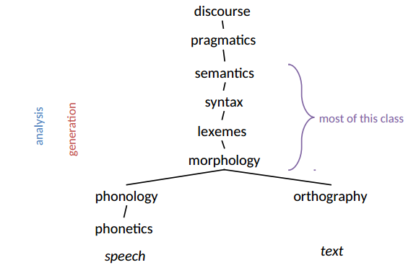
Levels of Representation

Slide 3
Outline
What is Syntax?
Constituency and English Phrases
Context-free Grammars

Slide 4
Syntax is not Morphology
Morphology deals with the internal structure of words
Syntax deals with combinations of words
Phrases and sentences
Morphology is often irregular
Syntax has its irregularities, but it is usually regular
Syntax is mostly made up of general rules that apply across-the-board

Slide 5
Syntax is not Semantics
Semantics is about meaning; syntax is about structure alone
A sentence can be syntactically well-formed but semantically ill-formed:
Colorless green ideas sleep furiously.
Some well-known linguistic theories attempt to “read” semantic representations off of syntactic representations in a compositional fashion

Slide 6
Constituency and English Phrases

Slide 7
Constituency
One way of viewing the structure of a sentence is as a collection of nested constituents
constituent: a group of words that “go together” (or relate more closely to one another than to other words in the sentence)
Constituents larger than a word are called phrases
Phrases can contain other phrases

Slide 8
Noun Phrase(NP)
The elephant arrived.
It arrived.
Elephants arrived.
The big ugly elephant arrived.
The elephant I love to hate arrived

Slide 9
Noun Phrase(NP)
The elephant arrived.
It arrived.
Elephants arrived.
The big ugly elephant arrived.
The elephant I love to hate arrived

Slide 10
Prepositional Phrases (PPs)
I arrived on Tuesday.
I arrived in March.
I arrived under the leaking roof.
Every prepositional phrase contains a noun phrase.

Slide 11
Prepositional Phrases (PPs)
I arrived on Tuesday.
I arrived in March.
I arrived under the leaking roof.
Every prepositional phrase contains a noun phrase.

Slide 12
Sentences or Clauses (Ss)
John loves Mary.
John loves the woman he thinks is Mary.
Sometimes, John thinks he is Mary.
It is patently false that sometimes John thinks he is Mary

Slide 13
Sentences or Clauses (Ss)
John loves Mary.
John loves the woman he thinks is Mary.
Sometimes, John thinks he is Mary.
It is patently false that sometimes John thinks he is Mary

Slide 14
CONTEXT-FREE GRAMMARS

Slide 15
Context-Free Grammar
Vocabulary of terminal symbols, Σ
Set of non-terminal symbols, N
Special start symbols, S ∈ N
Production rules of the form X → α where
X ∈ N
α ∈ (N ∪ Σ)*
The grammars are called “context-free” because there is no context in the LHS of rules—there is just one symbol. They are equivalent to Backus-Naur form or BNF.

Slide 16
Non-Terminals and Terminals
A non-terminal symbol is one like S that can (and must!) be rewritten as either
Other non-terminal symbols
Terminal symbols
Non-terminals can be phrasal or pre-terminal (in which case they look like part of speech tags— Noun, Verb, etc.)
In natural language syntax, terminals are usually words
They cannot be rewritten; they mean that you’re done

Slide 17
Context-Free Rules
S → NP VP
NP → Det Noun
VP → Verb NP
Det → the, a
Noun → boy, girl, hotdogs
Verb → likes, hates, eats
girl hates hotdogs
The girl likes

Slide 18
CFGs as Declarative Programming
One way to look at context-free grammars is as declarative programs
Think Prolog, SQL, or XQuery
Instead of specifying how the task is to be accomplished…
How sentences are to be generated
How sentences are to be parsed
CFGs specify what is to be computed in terms of rules and let generalized computation mechanisms solve for the particular cases
The same goes for regular expressions as well as other types of grammars

Slide 19
Building Noun Phrases
NP → Determiner NounBar
NP →ProperNoun
NounBar → Noun
NounBar → AP NounBar
NounBar → NounBar PP
AP → Adj AP
AP → Adj
PP → Preposition NP

Slide 20
Terminology
Grammatical: said of a sentence in the language
Ungrammatical: said of a sentence not in the language
Derivation: sequence of top-down production steps
Parse tree: graphical representation of the derivation
A string is grammatical iff there exists a derivation for it.

Slide 21
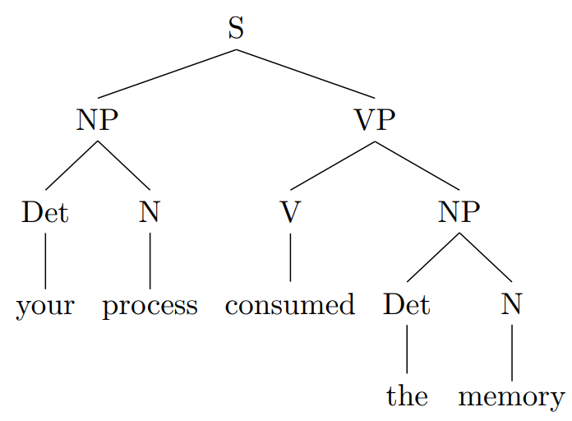
A (Constituency) Parse Tree

Slide 22
Ambiguity
S → NP VP
NP → Det Noun
VP → Verb NP
VP → VP PP
PP → Prep NP
Det → the, a
Noun → boy, girl, hotdogs, park
Verb → likes, hates, eats, sees
Prep → in, with

Slide 23
Grammaticality—It Varies
I'll write the company
I'll write to the company
It needs to be washed
It needs washed
They met Friday to discuss it
They met on Friday to discuss it

Slide 24
On Getting it Right
CFGs provide you with a tool set for creating grammars
Grammars that work well (for a given application)
Grammars that work poorly (for a given application)
There is nothing about the theory of CFGs that tells you, a priori, what a “correct” grammar for a given application looks like
A good grammar is generally one that:
Doesn’t over-generate very much (high precision)
Doesn’t under-generate very much (high recall)
What these look like in practice is going to vary with your application space

Slide 25
MOTIVATION

Slide 26
Why Are We Building Grammars?
Consider:
Oswald shot Kennedy
Kennedy was shot by Oswald
Oswald was shot by Ruby
Who shot Kennedy
Who shot Oswald?

Slide 27
Why Are We Building Grammars?
Active/Passive
Oswald shot Kennedy
Kennedy was shot by Oswald
Relative clauses
Oswald who shot Kennedy was shot by Ruby
Kennedy who Oswald shot didn't shoot anybody

Slide 28
Knowing Who Did What to Whom
There are multiple reasons to build grammars but one important reason is knowing who did what to whom
A parse tree does not tell us this directly, but it is one step in the process of discovering grammatical relations (subject, object, etc.) which can help us discover semantic roles (agent, patient, etc.)

Slide 29
Language Myths: Subject
Myth I: the subject is the first noun phrase in a sentence
Myth II: the subject is the actor in a sentence
Myth III: the subject is what the sentence is about
All of these are often true, but none of them is always true, or tells you what a subject really is (or how to use it in NLP).

Slide 30
SUBJECT, OBJECT, AND DEPENDENCIES

Slide 31
Subject and Object
Syntactic (not semantic)
The batter hit the ball. [subject is semantic agent]
The ball was hit by the batter. [subject is semantic patient]
The ball was given a whack by the batter. [subject is semantic recipient]
{George, the key, the wind} opened the door.
Subject ≠ topic
I just married the most beautiful woman in the world.
Now beans, I like.
As for democracy, I think it’s the best form of government.

Slide 32
Subject and Object
English subjects
agree with the verb
when pronouns, in nominative case (I/she/he vs. me/her/him)
omitted from infinitive clauses (I tried __ to read the book, I hoped __ to be chosen)
English objects
when pronouns, in accusative case
become subjects in passive sentences

Slide 33
Dependency Grammar
There is another way of looking at syntax that highlights relations like subject and object
Dependency grammar
Bilexical dependencies
Relationships between two words
One is “head” and one is “dependent”
Labels like “subj” and “obj” on arcs
Example: verbs are heads relative to their subject and objects, which are dependents

Slide 34
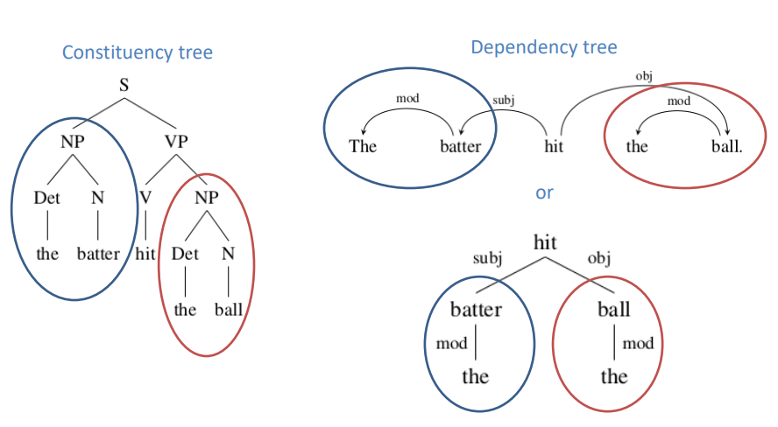
Dependencies

Slide 35
Advantages and Disadvantages
Advantages of Constituency/Phrase Structure Grammar
Advantages of Dependency Grammar
There are widely agreed-upon tests for constituency; there is little agreement above what constitutes a dependency relation
Constituency maps more cleanly on to formal semantic representations than dependency
This makes constituency useful in natural language understanding
It is easier to identify grammatical relations (like subject and object) in a dependency parse
Dependency parses of sentences having the same meaning are more similar across languages that constituency parses
Dependency parses are also useful for NLU (ask Google)
Dependency trees are typically simpler

Slide 36
Additional Notes
Some approaches to syntax, including Lexical Functional Grammar or LFG, use dependency and constituency as parallel representations
Stanford parser does both constituency and dependency parsing (Neural Network Dependency Parser)
Many other parsers for both constituency and dependency exist (e.g. Berkeley Parser, MaltParser, SyntaxNet & Parsey McParseface, TurboParser, MSTParser)

Slide 37
Looking Forward
We will talk a lot about constituency parsing and CFGs (more than about dependency grammar, though you may want to use a dependency parser in your project)
CFGs may not be entirely adequate for capturing the syntax of natural languages
They are almost adequate
They are computationally well-behaved (in that you can build relatively efficient parsers for them, etc.)
But they are not very convenient as a means for hand-crafting a grammar
Also, they are not probabalistic
In future lectures, we will revisit these properties of CFGs

